Slide 1
Good design
Cameron Shelley
STV 202

Slide 2
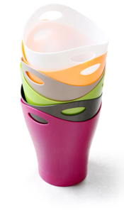
Case study: The Garbino
The central theme here is good design
What does “good design” mean to you?
The Garbino
Designed by Canadian Karim Rashid, 1997
In what ways is it a good, simple design? Not so?

Slide 3
Aspects of good design
Perspectives on good design
Technical
Clients
Designers
General public/Society
Good design involves the broader context
We will look from a technology-society perspective
Design
Society
Designers
Clients

Slide 4
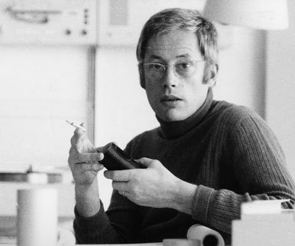
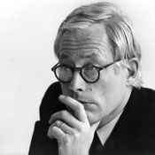
Dieter Rams (1932−)
An eminent 20th Century industrial designer
Influential to many others, e.g., Jonathan Ive
Attended the Handwerker-und-Kunstgewerbeschule, 1946−1953
Learned modernist design
Braun:
Joined 1955
Head of product design 1961
Co-designed > 500 products
Retired 1997
Awards include:
Royal Designer for Industry, 1968
World design medal, IDSA, 1996

Slide 5
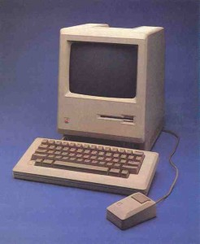

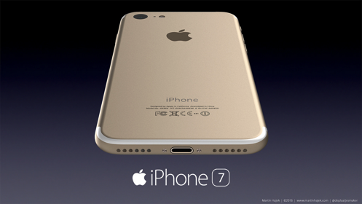
“Less but better”
Motto: “Weniger aber besser” = Less but better
Good design is minimalist
E.g., the lack of cursor keys on the Macintosh (Jobs)
Users already have the mouse!
Commandment of Good Design #10: Good design is as little design as possible
Less but better—because it concentrates on the essential aspects, and the products are not burdened with inessentials.
What about the iPhone 7 without an earphone jack? Other designs?

Slide 6
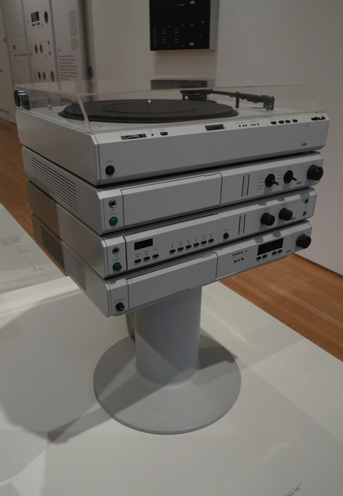
Omit the unimportant
Minimalism and importance
One of the most significant design principles is to omit the unimportant in order to emphasize the important… [e.g.,] items that have unconstricted obvious-seeming functionalism in both the physical and the psychological sense. Therefore, products should be well designed and as neutral and open as possible, leaving room for the self-expression of those using them. (p. 111)
How does this system satisfy “omit the unimportant”?
What other designs satisfy this criterion? Fail to satisfy it?
Commandment #6: Good design is unobtrustive
Products fulfilling a purpose are like tools. They are neither decorative objects nor works of art. Their design should therefore be both neutral and restrained, to leave room for the user’s self-expression.
Braun Atelier

Slide 7
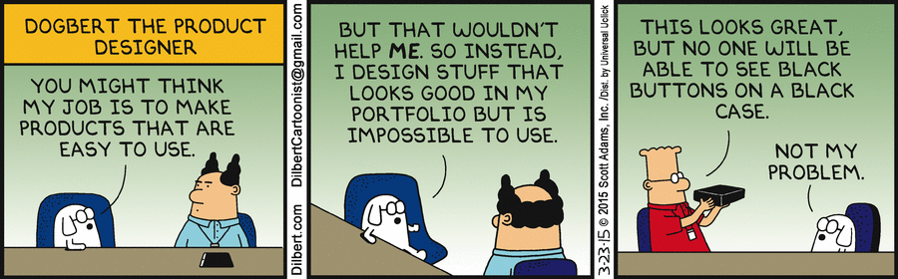
Dogbert, bad product designer

Slide 8

Clarity
Communicating clearly
… items should be designed in such a way that their function and attributes are directly understood… Design riddles are impudent and products that are informative, understandable, and clear are pleasant and agreeable. (p. 112)
In what ways is this design clear or legible?
What other designs are clear? Unclear?
Commandment #4: Good design makes a product understandable
It clarifies the product’s structure. Better still, it can make the product talk. At best, it is self-explanatory.
Braun ET 66

Slide 9
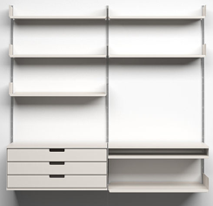
Progressive
Designers have social responsibilities:
Design means being steadfast and progressive rather than escaping and giving up. In a historical phase in which the outer world has become less natural and increasingly artificial and commercial, the value of design increases. The work of designers can contribute more concretely and effectively toward a more humane existence in the future. (p. 113)
How is this design progressive?
What other designs are progressive?
Vitsoe 606 USS

Slide 10
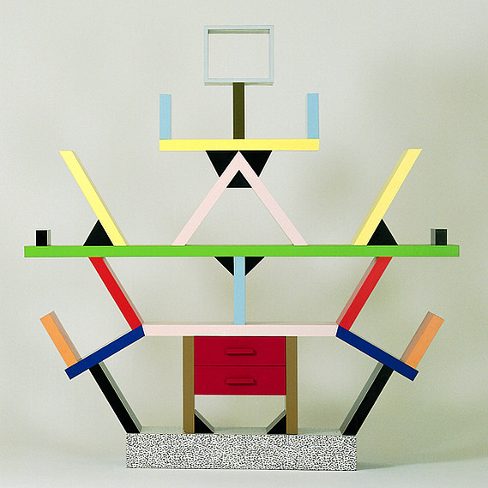
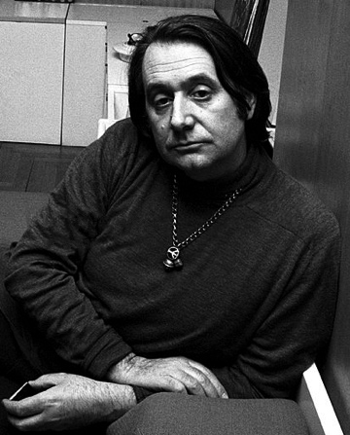
Case study: The Carleton
The Carleton bookcase (Sottsass 1981)
In what ways is the Carleton not progressive?
What other designs are not progressive?
Carleton bookcase
Ettore Sottsass

Slide 11
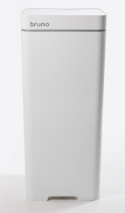
Innovative
Commandment #1: Good design is innovative
The possibilities for innovation are not, by any means, exhausted. Technological development is always offering new opportunities for innovative design. But innovative design always develops in tandem with innovative technology, and can never be an end in itself.
Consider the Bruno smart trash can
Is the Bruno innovative?
What other designs are innovative, or not?

Slide 12

Critique
Rams’s principles are largely negative
When should features be added?
Simplification can lead to dullness
“These are efficient objects, beautiful in their purposefulness, yet they fail to enlighten or revive their surroundings.” −Gadi Amit
This problem might undermine Rams’s social program
Others could “jazz up” minimalist designs
Perhaps minimal could be made “cool”?
Would that be underhanded?
Braun Citromatic

Slide 13
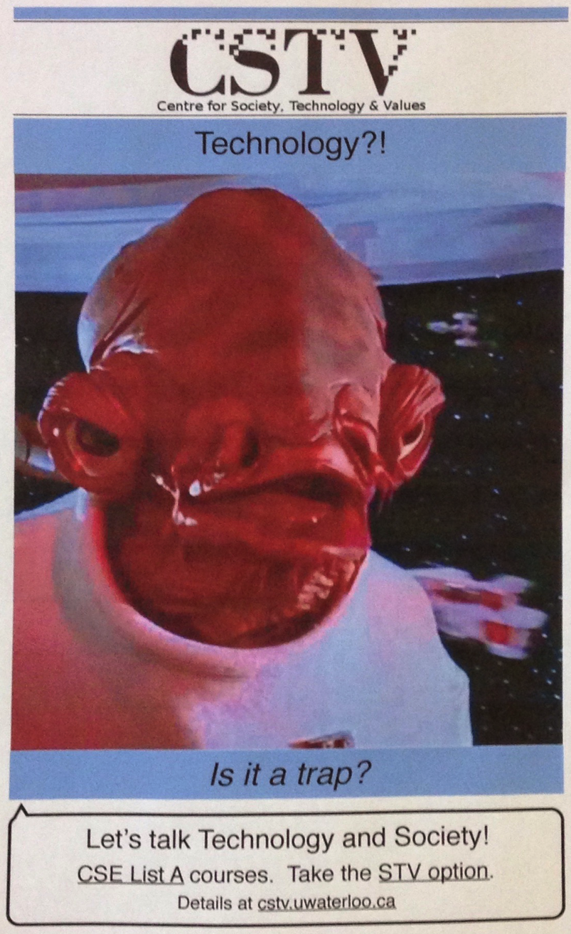

Administration
The syllabus
Auxiliary materials:
Blog: http://cstv.uwaterloo.ca
Twitter: @UW_CSTV
Your TA:
Graeme Epps

